Slide 1
Lesson 6: Creating a Secure Password Generator
Mack 2023
Notes:
Last updated: 10-17-2022

Slide 2
Warm Up

Slide 3
Make a prediction
Starter activity
1 2 3 4 5 6 | from random import randint random_number = randint(65,90) random_character = chr(random_number) print(random_character)
Questions .
What will be the output of print when this program is executed?
A single random capital letter
A single random lower case letter
random_character
A single number
▹
1
2
3
4
Why? .
65 to 90 on the ASCII table are all capital letters of the alphabet. The program generates a random capital letter.

Slide 4

Lesson 28: String handling III
Objectives
In this lesson, you will:
Create a program that uses string-handling techniques
Notes:
Secondary – objectives slides

Slide 5
Activity 1

Slide 6
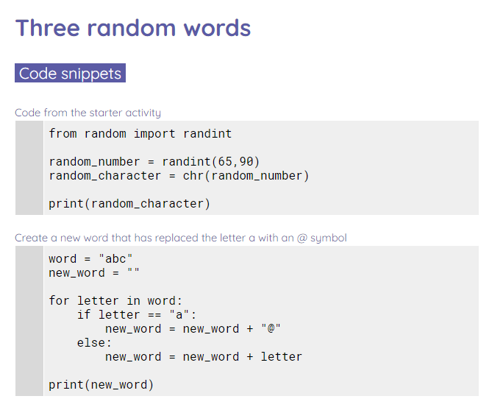
Three random words
Activity 1
Use the worksheet to create a program that generates a password based on three random words input by the user.

Slide 7

Solve the string-handling anagrams
Wrap Up
BURNTSSIG
TENTCONCAAE
MLEEENT
DEXIN
Explorer task
Write definitions for your solved anagrams.

Slide 8
Activity 2

Slide 9
Traversing a List
Activity 2
We can use indexes and onMousePress to cycle through the elements in a list, getting the element at the next index in the list! Read through Traversing a List!

Slide 10

Traversing a List
Activity 2
Complete 3 pts of exercises!

Slide 11
Wrap Up

Slide 12
Solutions
Wrap Up
SUBSTRING
CONCATENATE
ELEMENT
INDEX

Slide 13
Next lesson
Summary
In this lesson, you…
Created a program that generates a secure password based on three random words
Next lesson, you will…
Learn about arrays and lists

